Slide 1

Unlocking Student Performance Insights
Explore key factors influencing student achievement. Understand demographics, academic performance, and comparative insights to drive informed educational decisions.
By: DataNinja Team (Afolabi, Branson and Eniola)

Slide 2










Demographic Landscape
Race/Ethnicity
Gender Distribution
Examine diverse ethnic group presence.
Analyze male vs. female representation.
Parental Education
Understand education level impact.
Test Prep Completion
Assess course participation rates.
Lunch Type
Compare standard vs. subsidized meals.

Slide 3
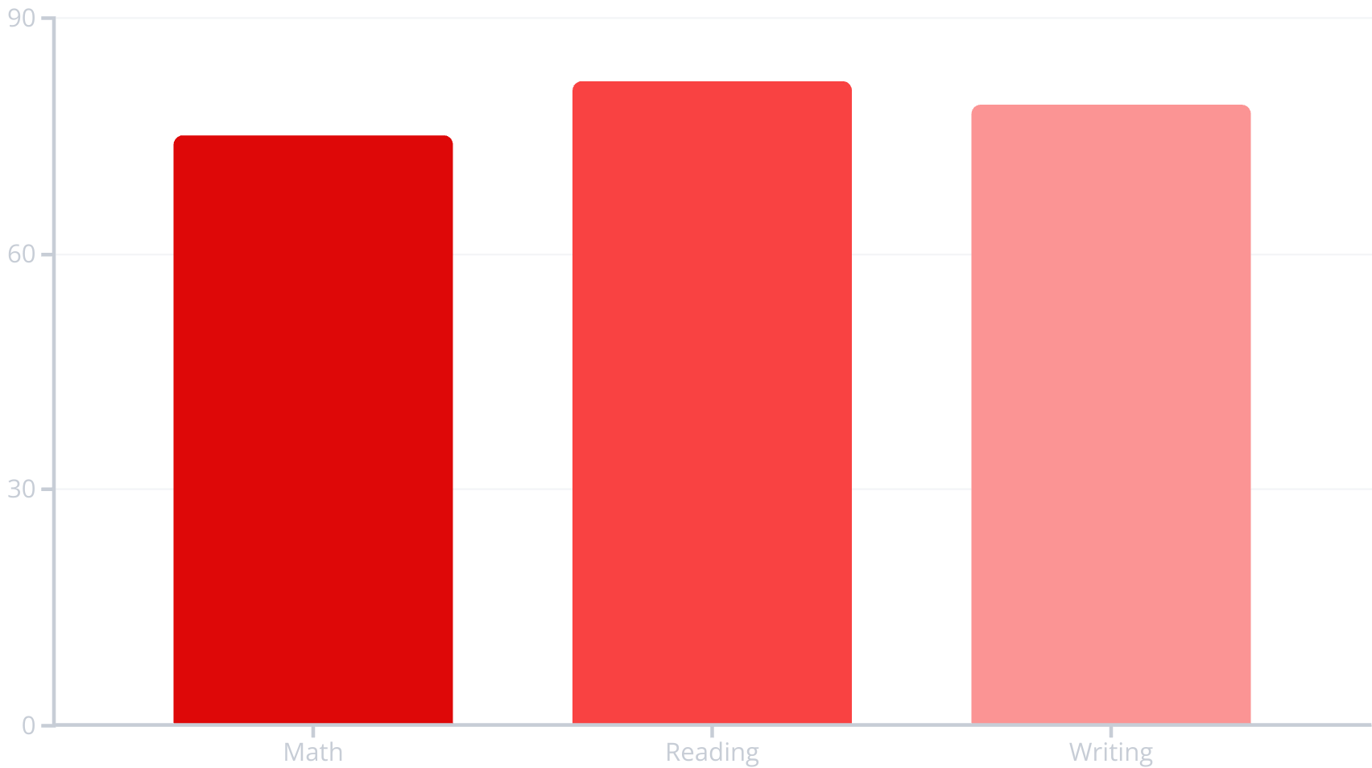

Academic Performance Overview
Key Metrics
Average scores by subject.
Score distribution insights.
Identify top/bottom performers.
These insights reveal overall academic strengths and areas needing improvement.

Slide 4





Comparative Analysis
Gender Gap
Performance differences between genders.
Ethnic Differences
Score variations across groups.
Lunch Type Impact
Correlation with academic outcomes.
Parental Education
Influence on student achievement.

Slide 5

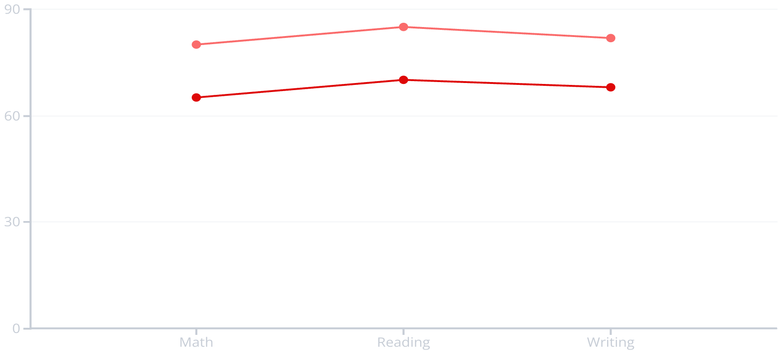
Test Preparation Effect
Without Test Prep
With Test Prep
Test preparation significantly impacts scores. Analyze average score differences with and without test prep.

Slide 6
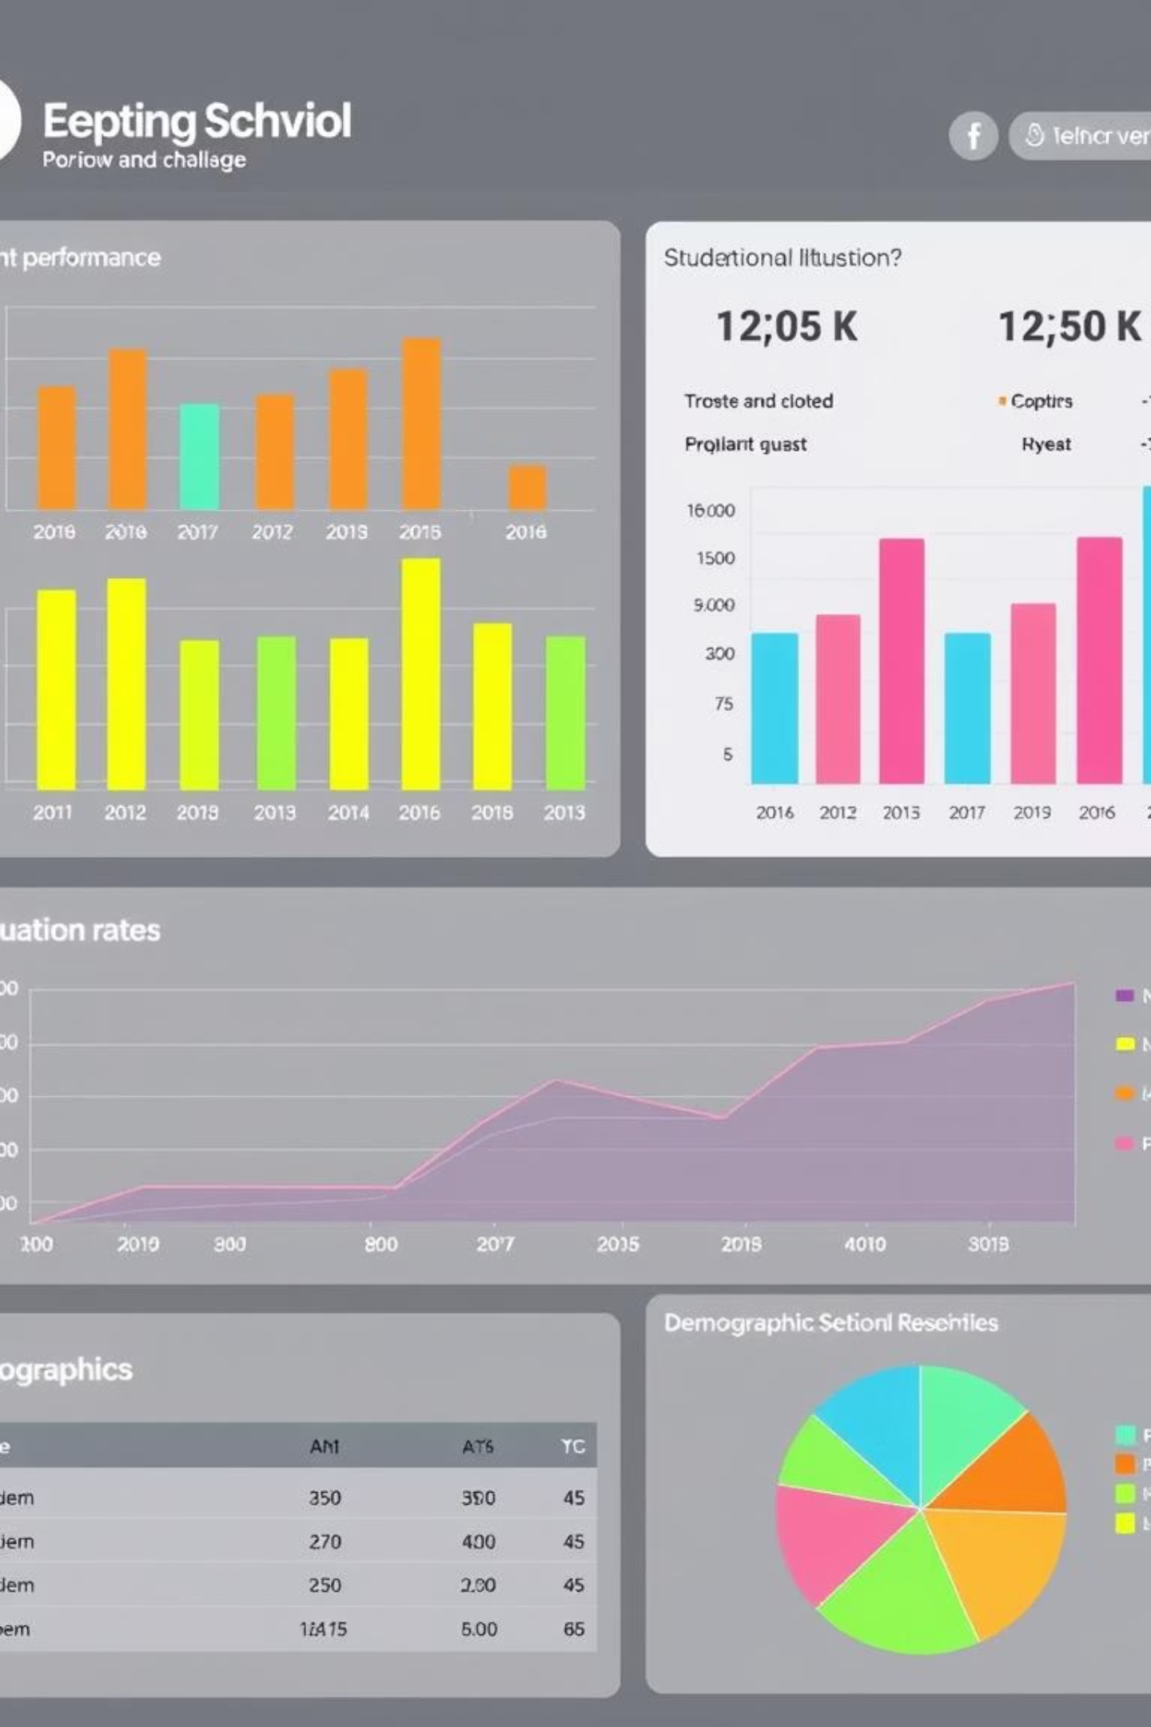
Derived Metrics for Deeper Analysis
Total/Average Score
Pass/Fail Rate
Comprehensive student performance.
Based on custom thresholds.
Score Improvement
Quantify test prep effectiveness.
These metrics provide a granular view of individual student progress and program efficacy.

Slide 7

Outlier and Risk Analysis
At-Risk Students
Identify low performance across subjects.
Specialized Talent
Excelling in one subject, struggling in others.
Early identification allows for targeted interventions and personalized support.

Slide 8




Next Steps and Dashboard Potential
Dynamic Filters
Slice data by demographics.
Group Comparison
Compare any two student groups.
Score Dashboards
Visual performance by variable.
Leverage interactive dashboards for continuous monitoring and data-driven educational strategies.

